Slide 1
Presentation Group 1
(SaaS in Healthcare)
By: Vraj Shah, Isaiah Bartlett, Nicholas Digioia-Celentano
Notes:
Cover Slide. Everyone introduces themselves

Slide 2
Topic
1. The topmost priority of the North Carolina Department of Health and Human Services (the Department) is the health and well-being of the individuals they serve. Your team is assigned to work on the usability testing of a SAAS application targeted for healthcare systems to be used by the served population. Think through the target audience, discuss and present the test plan for ensuring better usability of the mobile and web app. Focus on what constitutes usability to the target audience, and how your proposal addresses those concerns.

Slide 3
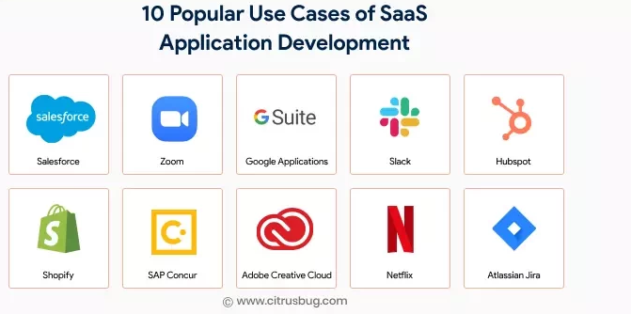
What is SaaS?
One of the three main categories of cloud computing
Software as a service (SaaS)
Infrastructure as a service (IaaS)
Platform as a service (PaaS)
Notes:
Software as a service also known as Saas allows users to connect and use cloud-based apps and services over the Internet without actually downloading them. Some examples of this are email, calendaring, and microsoft office. Software as a service provides a complete software solution that you purchase on a pay-as-you-go basis from a cloud service provider.
SaaS is one of three main categories of cloud computing, the other two are infrastructure as a service (IaaS) and platform as a service (PaaS).
Iaas is used by companies that want to outsource their data center and computer resources to a cloud provider. IaaS providers host infrastructure components such as servers, storage, networking hardware and virtualization resources.
PaaS provides a framework of resources for an organization's in-house developers. This hosted platform enables developers to create customized applications. The vendor manages the data center resources that support the tools.
SaaS application users as already stated do not have to download software, manage any existing IT infrastructures or deal with any aspect of the software management. Vendors handle maintenance, upgrades, support, security and all other aspects of managing the software
To make it short Software as a service (SaaS) is a software distribution model in which a cloud provider hosts applications and makes them available to end users over the internet.

Slide 4
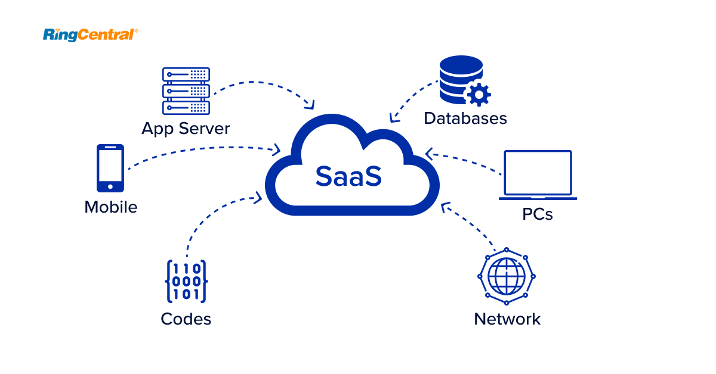
How Does SaaS Work?
Notes:
SaaS works through the cloud delivery model. A software provider will either host the application and related data using its own servers, databases, networking and computing resources, or it may be an ISV that contracts a cloud provider to host the application in the provider's data center. The application will be accessible to any device with a network connection. SaaS applications are typically accessed via web browsers.
As a result, companies using SaaS applications are not tasked with the setup and maintenance of the software. Users simply pay a subscription fee to gain access to the software, which is a ready-made solution.

Slide 5
Advantages and Disadvantages of SaaS
Advantages
Payment Options
Scalable usage
Automatic updates
Accessibility
customization
Disadvantages
Uncontrollable issues
Versioning Control
Switching vendors
Security
Notes:
Pros :
Payment options-. Rather than purchasing software to install, or additional hardware to support it, customers subscribe to a SaaS program. Moving costs to a recurring operating expense allows many businesses to exercise better and more predictable budgeting. Users can also cancel a subscription at any time to stop those recurring costs.
Scalable usage. Cloud services like SaaS offer high Vertical scalability, which gives customers the option to access more or fewer services or features on demand.
Automatic updates. Rather than purchasing new software, customers can rely on a SaaS provider to automatically perform updates and patch management. This further reduces the burden on in-house IT staff.
Accessibility. Since SaaS vendors deliver applications over the internet, users can access them from any internet-enabled device and location.
Customization. SaaS applications are often customizable and can be integrated with other business applications, especially across applications from a common software provider.
Cons:
Issues beyond customer control. Issues can arise when providers experience service disruptions, impose unwanted changes to service offerings or experience a security breach -- all of which can have a great effect on the customers' ability to use the SaaS offering.
Customers lose control over versioning. If the provider adopts a new version of an application, it will roll out to all of its customers, regardless of whether or not the customer wants the newer version. This may require the organization to provide extra time and resources for training.
Difficulty switching vendors. As with using any cloud service provider, switching vendors can be difficult. To switch vendors, customers must migrate very large amounts of data. Furthermore, some vendors use proprietary technologies and data types, which can further complicate customer data transfer between different cloud providers. Vendor lock-in is when a customer cannot easily transition between service providers due to these conditions.
Security. Cloud security is often cited as a significant challenge for SaaS applications.
Isaiah presents advantages, Nick presents disadvantages?

Slide 6
Why Use SaaS in Healthcare?
Cost effectiveness
Much cheaper to maintain, since there’s no maintenance cost
Fairly low initial investment
Easy to upgrade, when necessary
Data backups
Normally, it is the responsibility of the healthcare provider to back up data on-site
With SaaS platforms, data backups are kept continuously
If necessary, all healthcare data can be recovered
Notes:
Nick will present this

Slide 7
What are the Disadvantages?
Government Regulations
Different countries have different healthcare regulations
HIPAA (US), GDPR (EU), and PIPEDA (Canada)
SaaS provider might be located in a country other than your own
This could cause issues complying with healthcare regulations
Failure to comply with regulations results in heavy fines and jail time
“Loss of Control”
Data is now in the hands of a third-party
System outages and downtimes can prevent access to data
In healthcare, this can be a matter of life and death
Notes:
Nick will present this

Slide 8
What Constitutes “App Usability”? A Few Examples
Error Free
Give the user a comfortable, error-free experience, devoid of major bugs and crashes
Even the best UX designs will fail if there are errors
Ease of Use
Users should be able to immediately achieve their goal when using the app
Users should also be able to easily follow and understand the UI
Visibility
Minimize the user’s need to remember details from one screen to another
Necessary information should be able to be accessed at all times
Notes:
Nick will present this

Slide 9
Target Audience
Anyone seeking health care

Slide 10
Usability Testing of Healthcare App as a SAAS
A way to login to view information about your health and then logout
Security
Using Biometrics
oAuth 2.0
2 factor auth
View your health records
A clean UI which shows information about yourself such as age, gender, and etc.
Next Appointments
Integrated with google calendar or device calendar
Charts and graphs of your health
A quick way to see how healthy you are and what needs work
A way to share your health information to other doctors or other professionals who require it.
This makes it easier then having to fill out forms everytime you go an appointment
Notes:
Vraj will present this

Slide 11
Demo Application
Link to figma
Notes:
Vraj will present this

Slide 12
Sources
https://www.techtarget.com/searchcloudcomputing/definition/Software-as-a-Service
https://www.givainc.com/blog/index.cfm/2022/7/13/advantages-disadvantages-cloud-computing-in-health-sector
https://clearbridgemobile.com/7-best-practices-to-overcome-mobile-app-usability-issues/

Slide 13
Q&A
Thank you all for listening!
Any questions?

